Slide 1


Exploring the World of Blockchain
Blockchain technology is revolutionizing industries by offering a secure, transparent, and efficient way to record and verify transactions. This presentation will delve into the core concepts, applications, and potential of this transformative technology, exploring its impact across diverse sectors and addressing key challenges and future trends.

Slide 2
Decentralization and the Distributed Ledger
Centralized Systems
Decentralized Systems
Traditional systems rely on a central authority (e.g., a bank) to control and manage data. This creates single points of failure and vulnerability to manipulation.
Blockchain employs a distributed ledger, replicating data across multiple nodes. This eliminates single points of failure and enhances security and transparency.

Slide 3
How Blockchain Works: Cryptography and Consensus
Cryptography: Securing the Data
Consensus Mechanisms: Building Trust
Blockchain uses cryptographic hashing to link blocks together, creating a secure chain. Each block's hash depends on the previous block's data, making any alteration easily detectable.
Consensus mechanisms like Proof-of-Work (PoW) or Proof-of-Stake (PoS) ensure all nodes agree on the blockchain's state. These mechanisms prevent fraudulent transactions and maintain the integrity of the network.

Slide 4


Key Blockchain Applications
Cryptocurrency
Smart Contracts
Digital currencies like Bitcoin utilize blockchain for secure and transparent transactions, eliminating intermediaries and offering greater financial autonomy.
Self-executing contracts with predefined terms automate agreements, reducing the need for intermediaries and ensuring trust and efficiency in transactions.
Supply Chain Management
Tracking goods from origin to consumer enhances transparency, security, and accountability, reducing fraud and improving efficiency across the supply chain.

Slide 5



Blockchain's Impact on Industries
Finance
Healthcare
Real Estate
Improved security, transparency, and efficiency in transactions, reducing fraud and streamlining processes.
Enhanced data security and interoperability, improving patient privacy and facilitating seamless data sharing.
Increased transparency and security in property transactions, reducing fraud and streamlining the buying and selling process.

Slide 6


Advantages of Blockchain Technology
Enhanced Security
Improved Transparency
Cryptography and distributed ledgers make blockchain highly resistant to tampering and fraud, protecting sensitive data and ensuring trust.
All transactions are recorded on a public ledger, providing complete visibility and traceability, increasing accountability.
Greater Efficiency
Automation and reduced reliance on intermediaries streamline processes, saving time and costs while speeding up transactions.

Slide 7


Challenges and Limitations of Blockchain
Scalability Issues
Regulatory Uncertainty
Many blockchains struggle to handle a large number of transactions, leading to slower processing times and higher fees. Solutions like sharding and layer-2 scaling are being explored to address this.
The lack of clear regulatory frameworks in many jurisdictions creates uncertainty for businesses and developers, hindering wider adoption and innovation.
Energy Consumption
Security Risks
Some consensus mechanisms, particularly Proof-of-Work, require significant computing power, resulting in high energy consumption and environmental concerns.
While generally secure, blockchains are not immune to vulnerabilities. 51% attacks, smart contract bugs, and phishing scams remain potential risks.

Slide 8

Benefits of Blockchain in Real Estate
Increased Transparency
Enhanced Security
All transactions are recorded on a public, immutable ledger. This boosts trust and accountability.
Cryptography secures transactions, reducing fraud and disputes. This creates a more reliable system.
Streamlined Processes
Reduced Costs
Smart contracts automate processes, reducing delays and costs. Efficiency gains are significant.
Automation and transparency minimize intermediaries, lowering transaction fees. Savings are passed on.

Slide 9
Smart Contracts and Transactions
1
Initiation
The buyer and seller agree on the terms of the transaction.
2
Contract Creation
A smart contract is created and uploaded to the blockchain.
3
Execution
Upon meeting pre-defined conditions, the contract automatically executes.
4
Verification
All parties verify the transaction on the immutable blockchain record.
5
Completion
The transaction is finalized, recording property ownership transfer.

Slide 10
Decentralized Property Ownership Records
Centralized System
1
Traditional systems rely on central authorities.
Blockchain Integration
2
Integrating blockchain enhances security and transparency.
Decentralized Database
3
Property records are stored across a distributed network.
Immutable Records
4
Changes are tracked and verified, ensuring data integrity.
Secure Access
5
Authorized users can access records securely and efficiently.

Slide 11





Streamlining the Title Search Process
Request Initiation
A title search request is submitted.
Blockchain Query
The blockchain is queried for relevant records.
Data Retrieval
Secure access to verified property data.
Verification
Automated verification of ownership history.
Report Generation
A comprehensive title report is generated.

Slide 12

Tokenization of Real Estate Assets
100M
$10K
Increased Liquidity
Lower Barriers
Tokenization allows fractional ownership, boosting trading.
Smaller investments become feasible, opening markets.
24/7
10%
Global Access
Reduced Costs
Trading occurs anytime, anywhere globally.
Transaction fees drop due to automation.

Slide 13
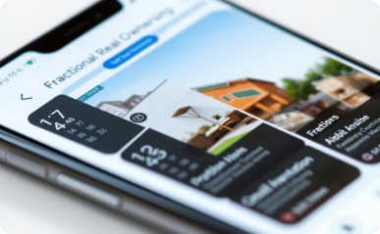

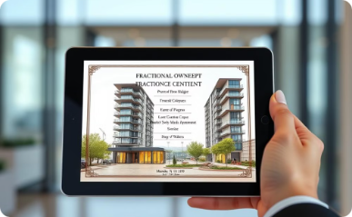
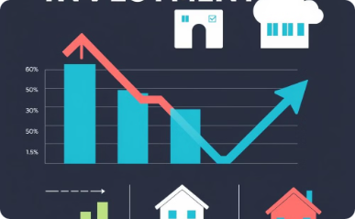
Fractional Ownership and Investment
Accessibility
Diversification
Liquidity
Potential Returns
Lower barriers to entry for investors.
Spread risk across multiple properties.
Easier to buy and sell fractional shares.
Share in rental income and property appreciation.

Slide 14
Challenges and Limitations
Scalability and Cost
Regulatory Uncertainty
Technological Complexity
Interoperability Issues
Handling large real estate datasets can be expensive. Transaction speeds may need improvement for widespread adoption.
Clear legal frameworks are crucial. Existing regulations may not fully address blockchain's implications.
Blockchain technology requires specialized expertise. Integration with existing systems can be complex.
Different blockchain platforms may not communicate easily. Standardization is needed for seamless transactions.

Slide 15





Future Outlook and Emerging Trends
Blockchain technology in real estate is rapidly evolving.
Wider Adoption
1
Increased acceptance by industry players.
2
Improved Scalability
Enhanced efficiency and speed.
3
Regulatory Clarity
Clearer legal frameworks emerge.
4
Global Interoperability
Seamless cross-border transactions.
5
New Applications
Innovative uses in property management.
The future is bright for blockchain in real estate. It promises greater transparency, efficiency, and security.

Slide 16
THANK YOU

